Slide 1
PARASITE
The importance of space
Data insights

Slide 2
Intro.
Where does Parasite takes place?
      Park’s house: 66 %
      Kim’s house: 14 %
      Other Seoul’s locations: 14 % (grouping many locations)
        Fun fact: Mr. Park car: 6%

Slide 3
Parks’ house
Main location. Where is the action taking place?
  Across the film:
By Room
By Floor
      29% Living Room
      15% Kitchen & Garden (each)
      12% Cave & Da Hye’s room (each)
      63% Level 0
      22 % Street & Underground
      16% First floor
Over time:
Bunker, Basement and garden gain momentum as the film evolves.

Slide 4
Characters & appearance
    Characters that appear the most in the house:
      Ki Woo: 15,2%
      Ki Taek: 14.1 %
      Ki Jung: 13.7%
      Yeon Kyo: 11.7%
      Chung Sook
      Moon Gwang
      Geun Se
      Mr. Park
      Da Song
      Da Hye
    By Family:
      Kim: 46.6%
      Park: 31.6%
      First: 21.8%
    If we were to account all the time that we see these characters in the house up to 46.6% correspond to Kim, which is ironic with the topic of the film.
    The character that introduces us to the house is the same tha drives more action Ki Woo (15%) of screen time.

Slide 5
Characters & occupation
    As we descend in the house levels. Park occupation decreases. They barely touch the lower levels of the house and Street. Leaving that for the lower social classes.
    On opposite of the ranking. Geun Se and his family win weigth there. They barely reach the upper levels (significant class status).
    The Kims have an even distribution among the house. (50%) Proving how well they have played their cards in this hoax. Coming from a poor background they reach the higuer levels of the house.
    Though trhourh as time evolve they tend to lead to the lower levels of the house (50 8th-42% 9th scene, 100% on last sceen)*. Proving the inestability of their game.
    What character occupies what level:
      Level 2:
        Da Hye: 38.05%
        Ki Woo: 37.75%
        Yeon Kyo: 12.39%
        Ki Taek: 3.14%
        Ki Jung: 2,97%
        Da Song: 2,21%
        Mr Park: 1,45%
      Level 1:
        Ki Jung: 17,22%
        Yeon Kyo: 14.02%
        Ki Taek: 14%
        Chung Sook: 12.74%
        Ki Woo: 11.88%
      Level 0:
        Moon Gwang: 23,27%
        Geun Se: 21.25%
        Ki Taek: 19.66%
        Ki Woo: 13.85%
        Ki Jung: 8.61%
    By Family:
      Level 2:
        Parks: 50.56%
        Kims: 48.54%
        First: 0,89%
      Level 1:
        Kims: 50.64%
        Parks: 36.49%
        First: 12.85%
      Level 0:
        Kims: 50.61%
        First: 43.54%
        Park: 5.84%

Slide 6
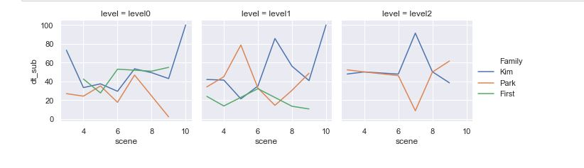
Character & occupation
* Evolution of occupation by family of House levels.

Slide 7
Families & movement
Who is the family the most static?
Out of their total time in screen:
  Parks 77%
  First 76.8%
  Kim 46.9%
Who is the family that moves up/down the most?
Out of their total time in screen:
  First 59.5%
  Kim 21.1%
  Parks 6.5%
    We start seeing some patterns here:
    The characters that go up/down more often are Geun Se and Moon Gwang. Either because they work in the service or because they want to escape from the lower levels.
    The static distribution is equally distributed among families. But what is important is? Where are they static??*
    Movement also expresses class status. Though in this case it also tells a lot.
Who is the family that moves the most?
Out of their total time in screen:
  First 95.1%
  Parks 76.5%
  Kim 70.1%

Slide 8
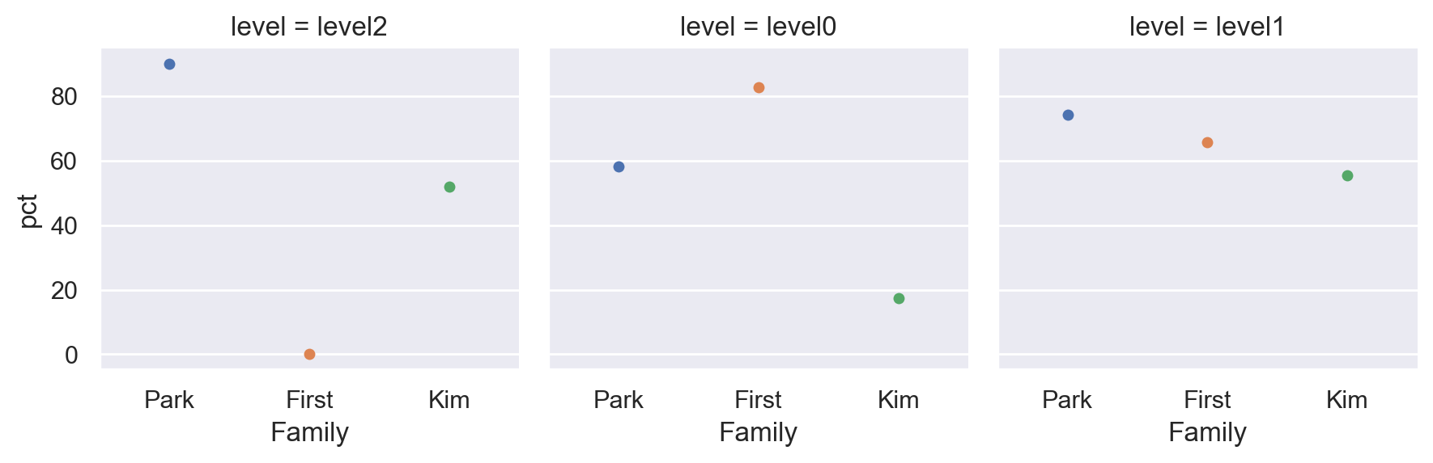
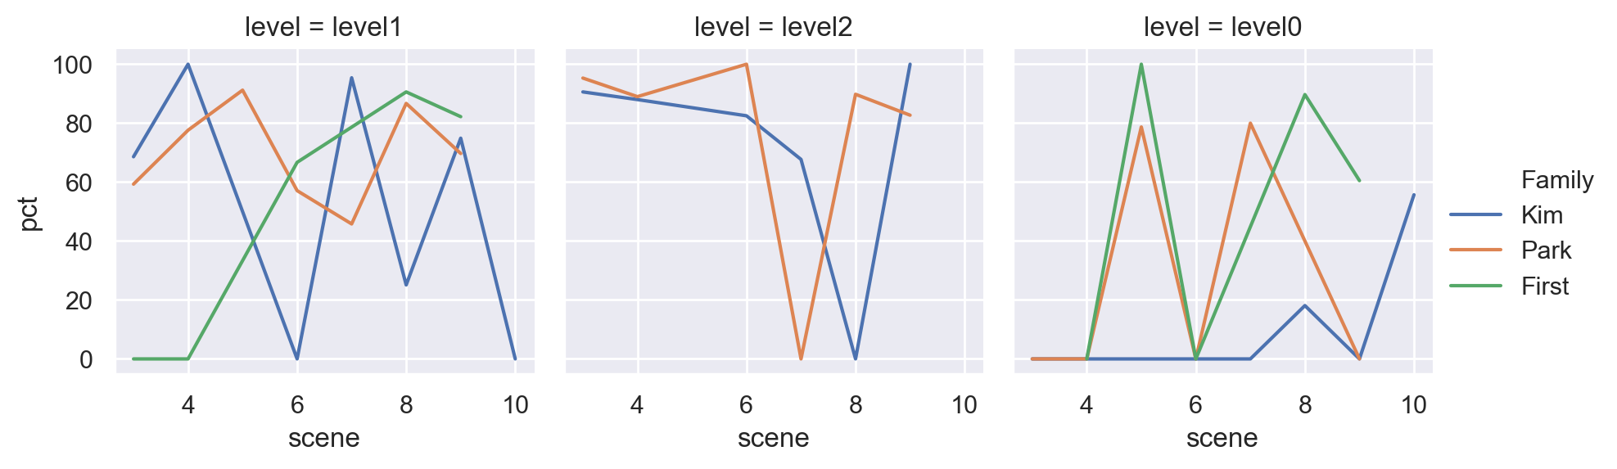
Families & movement
Negligible. Parks only stay 5,84% of the level0 time
Static
Whereas the static concentration of rich Parks is in the upper parts of the house. The first stays static the most in level=0. This is caused by their condition of servants.
Level 1 Works as a melting point.
Negligible. First only stay 0.84% of the level0 time
Over time

Slide 9
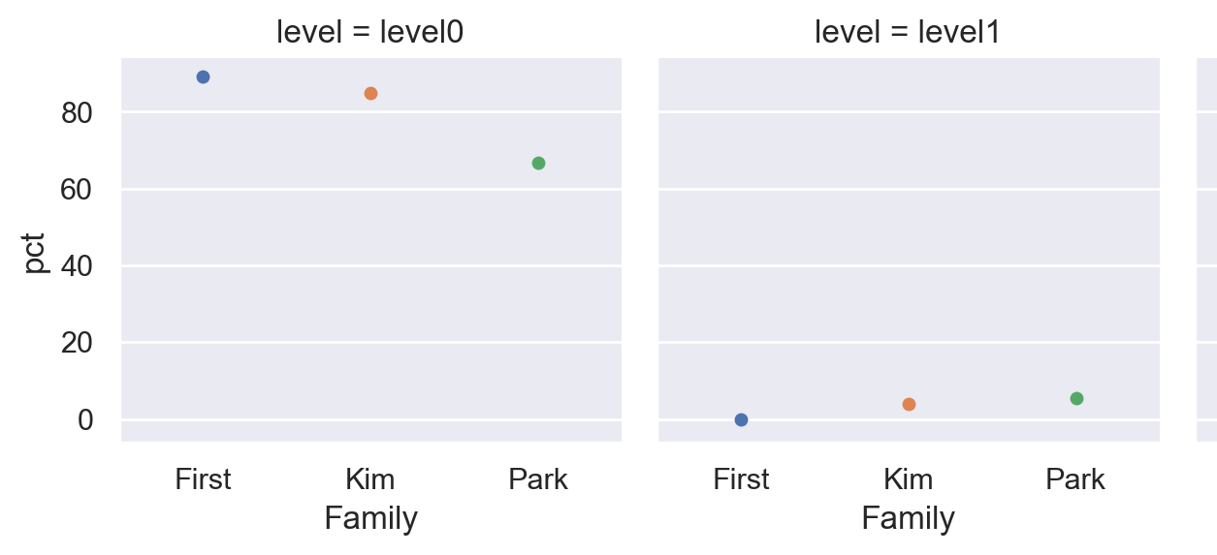
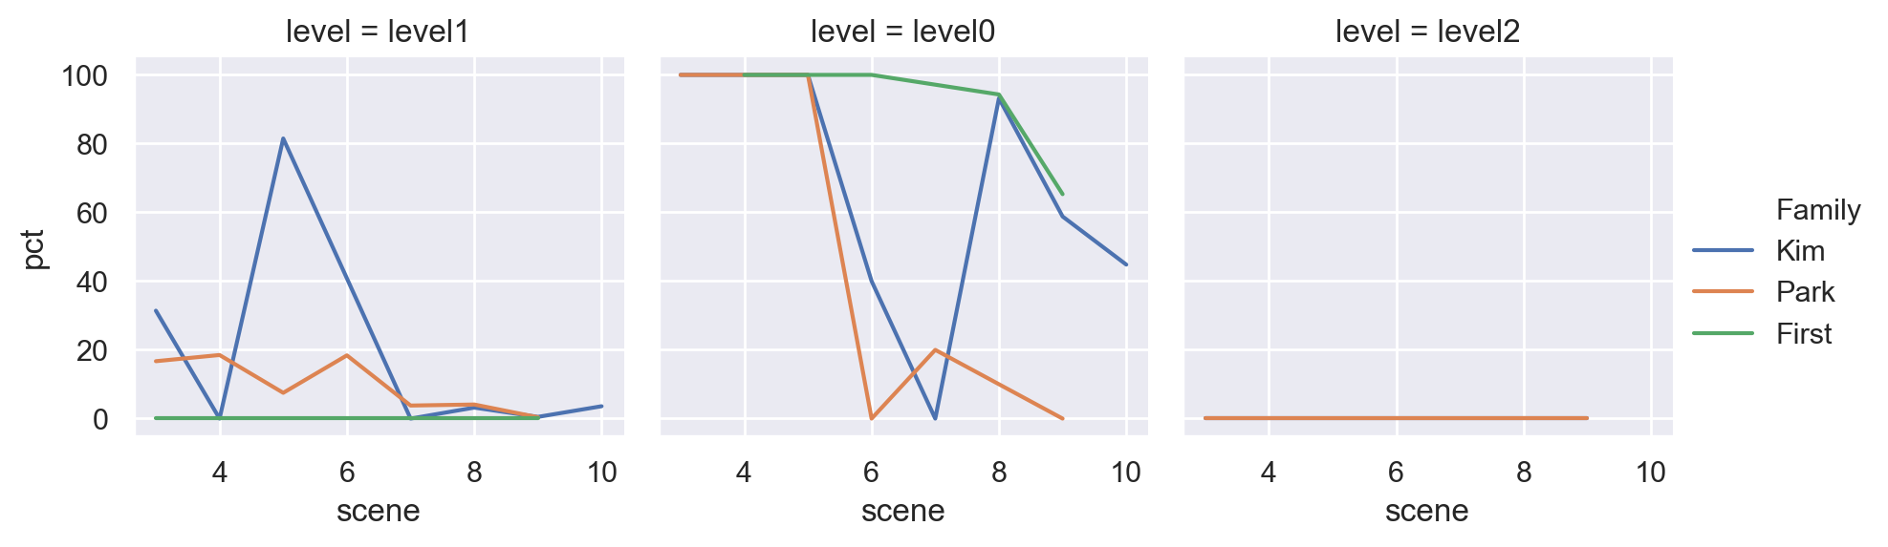
Families & movement
Negligible. Parks only stay 5,84% of the level0 time
Up Down
Level 0 is the focus of Up/Down movement. Characters try to escalate their life positioning by scaping from this level.
Level 1 Works as a melting point.
Over time

Slide 10
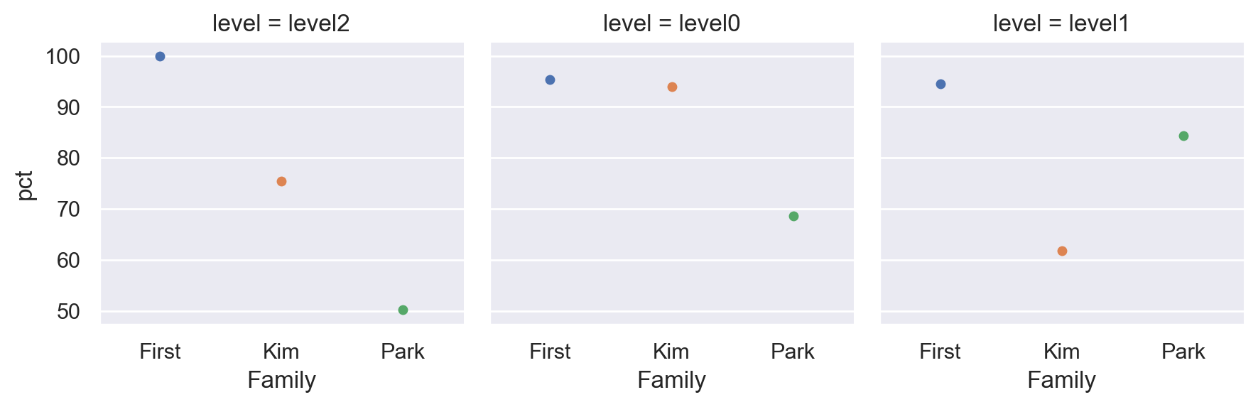
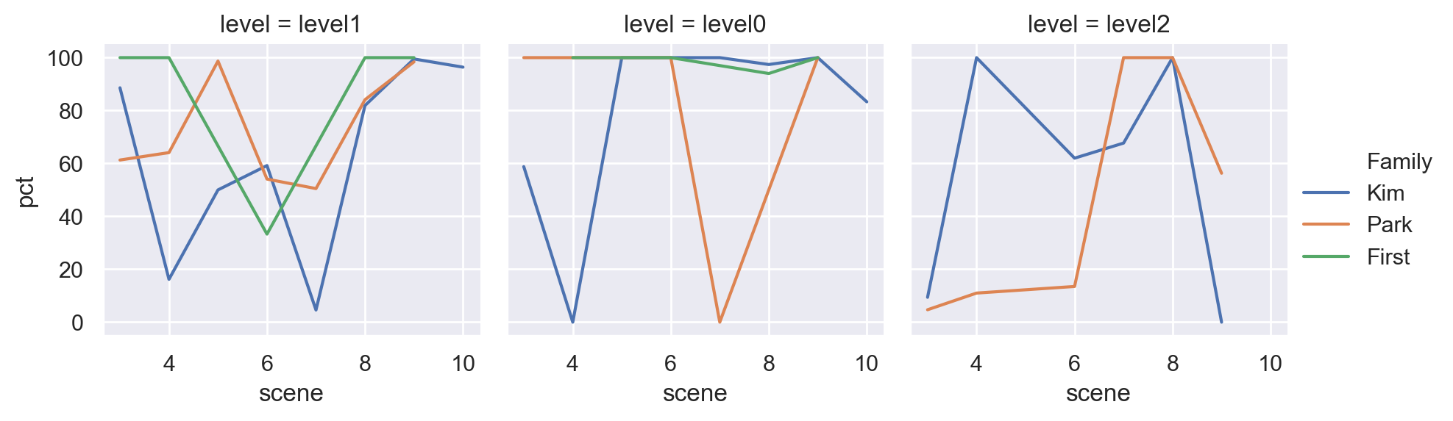
Families & movement
Negligible. Parks only stay 5,84% of the level0 time
Negligible. First only stay 0.84% of the level0 time
Move
Kim family stays as much moving as static in level 2. This proves the mirage thay have been living. Never accomodated.
Kims and First move a lot in level 0.
In level 1, First moves a lot beause at the beggining they were the service.
Over time

Slide 11
Characters & movement
Who is the character the most static?
Out of their total time in screen:
  Da Hye 88.7%
  Geun Se 86,24%
  Mr Park 86,2%
  DaSong 84%
  Moon Gwang 68.9
  Yeon Kyo 64.1
  Ki Taek 56.8%
Who is the character that moves up/down the most?
Out of their total time in screen:
  Moon Gwang 57.8%
  Geun se 61.7%
  Ki Taek 26.5%
  Ki Woo 22.3%
  Ki Jung & Chung Sook 17,5%
    Visualizations on characters, scene, time and movement are not informative. Too much info.
    Static on the contrary is a miced
    Geun Se is the second carácter more static. An análisis by área reveals the truth.
    Poor families move up and down the most. Trying to scalate as much as possible from inferior levels
Who is the character that moves the most?
Out of their total time in screen:
  Geun Se 99.6%
  Mr. Park 93%
  Moon Gwan 95.1%
  Da Song 82%
  Yeon Kyo, Chug Sook,Ki Taek, Ki Woo, Ki Jung 60 to 78%

Slide 12
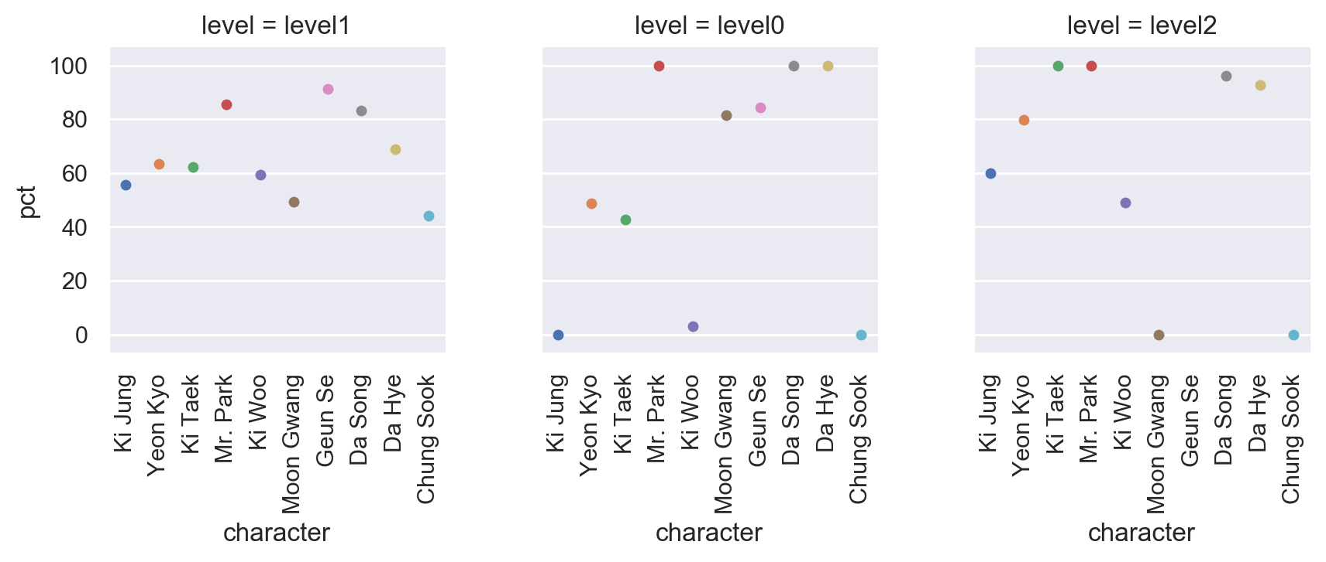
Characters & movement
Negligible.small %
Static
Static Da Hye in the second floor
Their static position comes from being locked in level 0

Slide 13
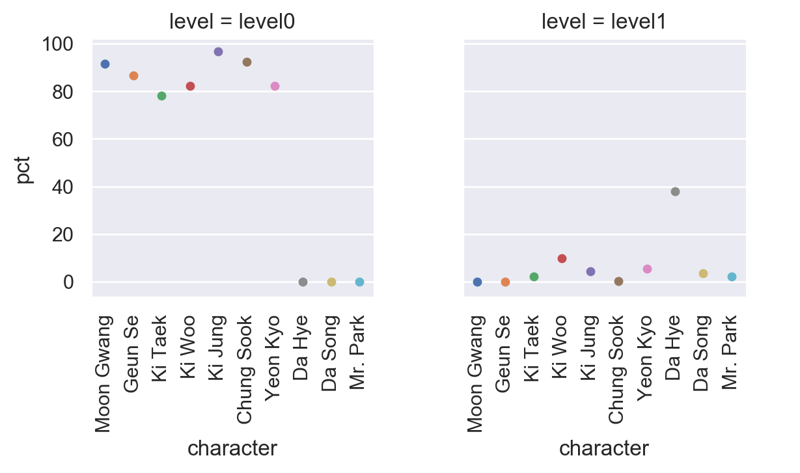
Characters & movement
UP/Down

Slide 14
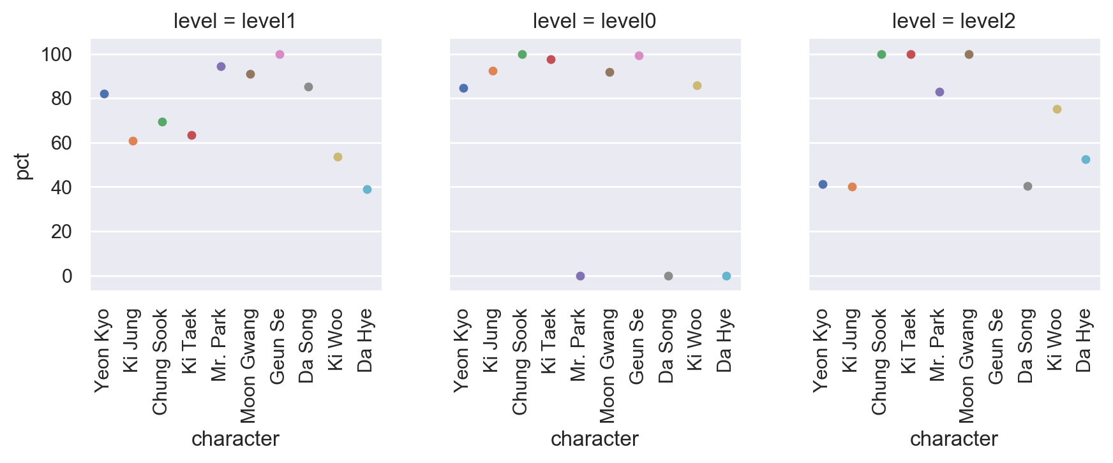
Characters & movement
Move

